Slide 1
JALPAIGURI GOVERNMENT ENGINEERING COLLEGE
PROJECT :- Automatic Class Attendance System Based On Face Detection And Recognition
THE PROJECT IS SUBMITTED BY :
SWAPNONEEL DUTTA MAJUMDAR – 18101106011
SUDIP MAHATA – 18101106009
DIPESH KR BURNWAL – 19101106089
RONOJIT CHAKRABORTY – 18101106033
Under the supervision of ADITYA KUMAR SAMANTA, Information Technology, Jalpaiguri Government Engineering College

Slide 2
Outline :
1. Introduction
2. Algorithm ( flow chart )
3. Functional Block Diagram
4. Results
5. Conclusion
6. Future Work

Slide 3


Introduction :
Traditionally attendance is marked manually by teachers and they must make sure correct attendance is marked for respective student.
This whole process wastes some of lecture time and part of correct information is missed due to fraudulent and proxy cases.

Slide 4
Introduction :
In order to determine classroom attendance, face detection and face recognition are performed. Face detection is used to determine the location of the faces in the classroom image and extract sub images for each face. Then, in face recognition, the face images detected will be compared with the data base consisting of images of students in the class, and attendance will be recorded accordingly.

Slide 5




Significance:
1-Automated
3-Effective
2- Keep save extra time

Slide 6
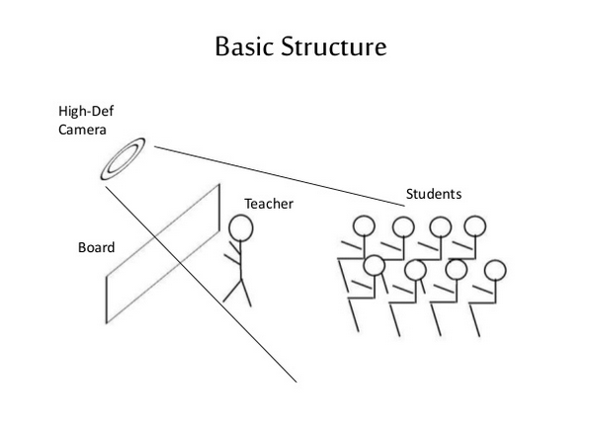

Slide 7
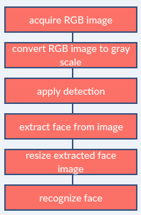
Image processing:

Slide 8
Face Detection:
Face detection is a computer technology used to identify human faces in digital images by determining the location of the faces in the image and extract sub images for each face.
Viola Jones algorithm will be implemented to recognize face and non-face patterns and enable us to identify locations of the faces in the image.

Slide 9
WHAT IS Viola Jones algorithm ?
Developed in 2001 by Paul Viola and Michael Jones, the Viola-Jones algorithm is an object-recognition framework that allows the detection of image features in real-time.
Despite being an outdated framework, Viola-Jones is quite powerful and its application has proven to be exceptionally notable in real-time face detection.

Slide 10
How it works?
There are 2 stages in the Viola-Jones Algorithm:
Training
Detection
1. Training :-
let’s move on to training. So what exactly do we mean we say training? We’re training the machine to identify these features. We’re feeding it information, and subsequently training it to learn from the information to predict. So ultimately, the algorithm is setting a minimum threshold to determine whether something can be classified as a feature or not.
The algorithm shrinks the image to 24 x 24 and looks for the trained features within the image

Slide 11
2. Detection:-
Viola-Jones was designed for frontal faces, so it is able to detect frontal the best rather than faces looking sideways, upwards or downwards. Before detecting a face, the image is converted into grayscale, since it is easier to work with and there’s lesser data to process. The Viola-Jones algorithm first detects the face on the grayscale image and then finds the location on the colored image.
It is essentially searching for these haar-like features, which will be explained next slide.

Slide 12
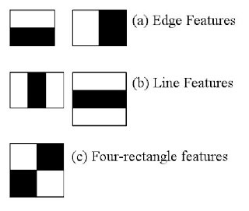
HAAR-like features:
The features show a box with a light side and a dark side, which is how the machine determines what the feature is. Sometimes one side will be lighter than the other, as in an edge of an eyebrow. Sometimes the middle portion may be shinier than the surrounding boxes, which can be interpreted as a nose.
There are 3 types of Haar-like features that Viola and Jones identified in their research:
Edge features
Line-features
Four-sided features

Slide 13
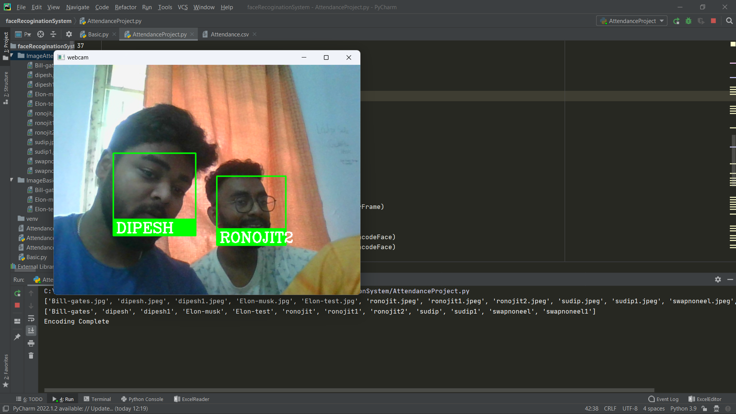
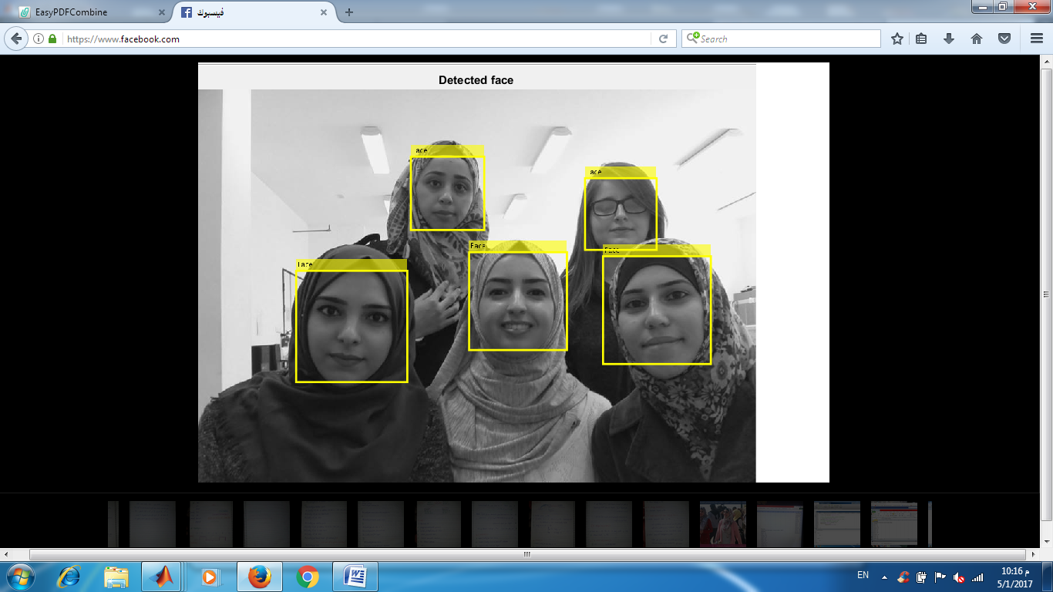
Example for detect face :

Slide 14
How Do We Create Database
Database is the collection of face images and extracted features. And the database includes names of students for each student .
We created a data base for 4 persons, were we took 12 images per person using PYTHON model WEBCAM, these images were taken at different times and with variations in illumination, facial expressions, and facial details.

Slide 15
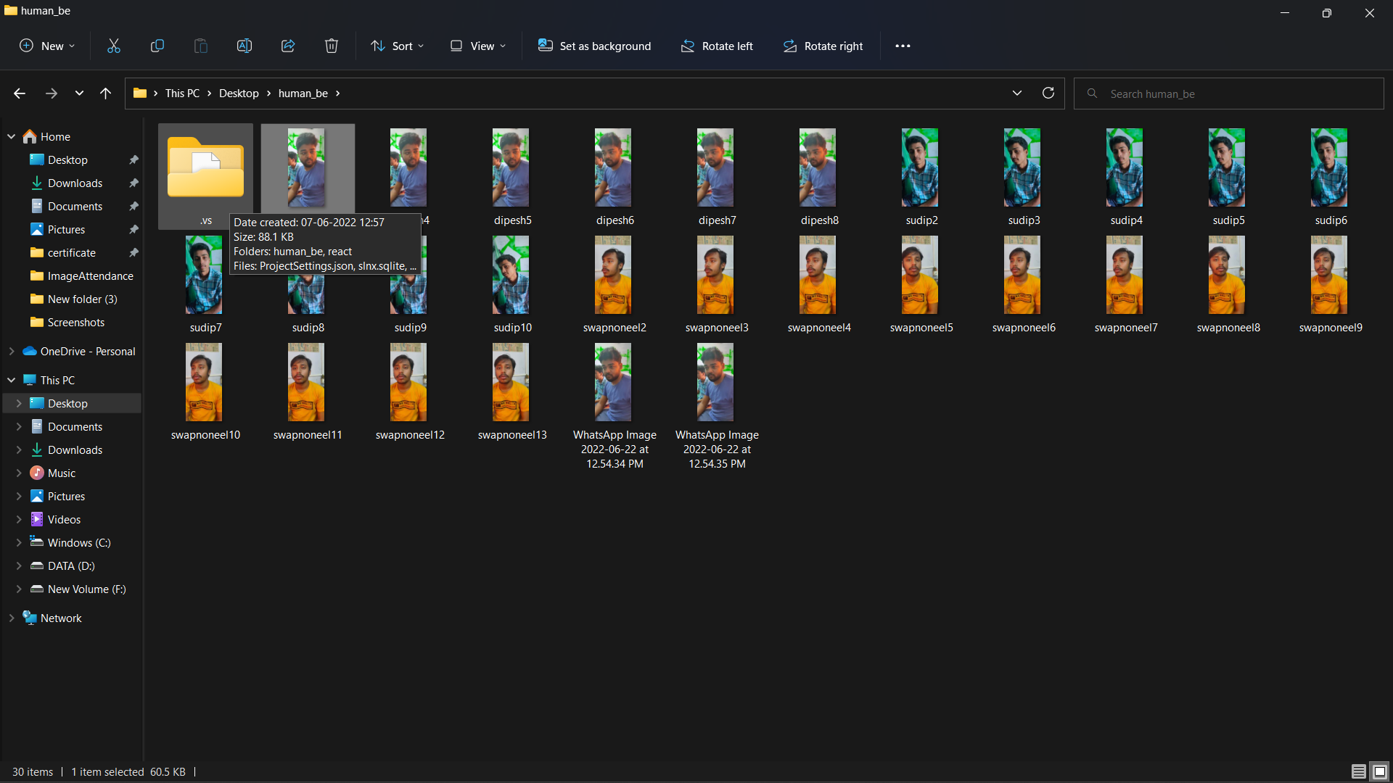
Example for data base images:

Slide 16
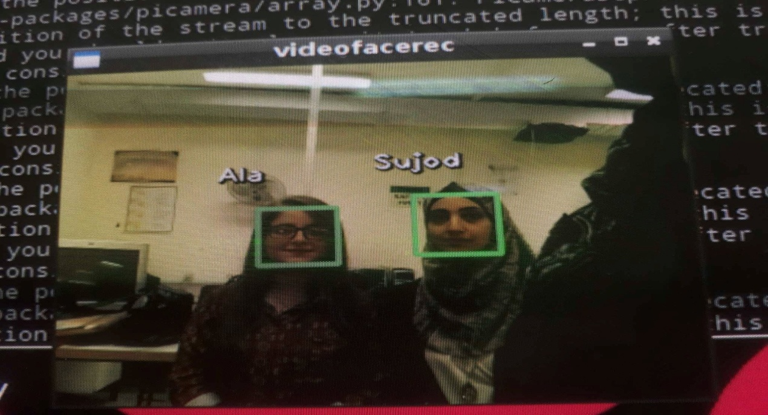
When we applied the openCV python code, the code was able to successfully recognize the faces, it detect the faces and write the names of recognized persons as shown:

Slide 17
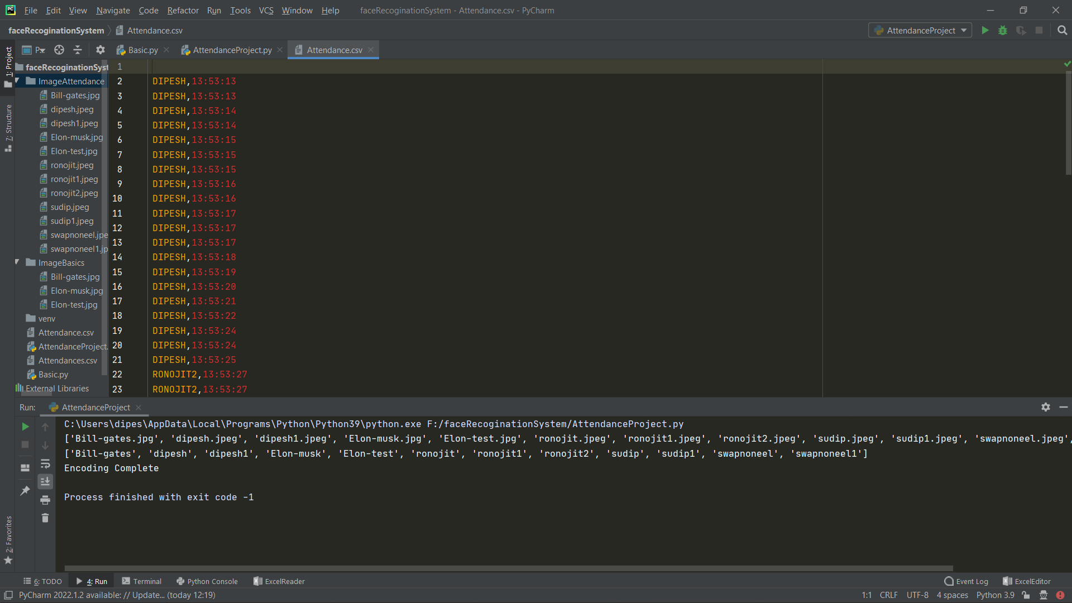
Then the code will creates a text file for present students as shown:

Slide 18
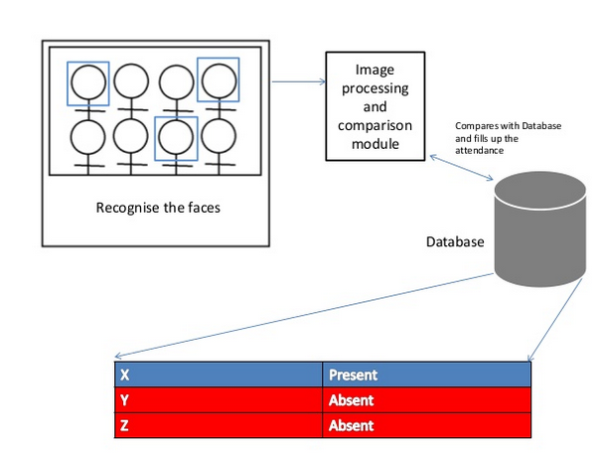

Slide 19
The problem that we faced
In our project we have faced many of problems and we have overcome them:
1- Download Python and library for it on PyCharm.
2- Version of numpy, opencv, face-recognition system.
3- Establish connection between python and image database.

Slide 20
Conclusion:
This technique is efficient method for automatic attendance and it can replace the traditional method.
Most system is time consuming and need human interference but face recognition solve both this problems. All we need a camera and laptop.

Slide 21
Future work
Automatic attendance system can be improved by increasing the number of features which can be extracted to increase accuracy of face recognition. Once the software is developed and tested properly, it could be improved to cover full institutions such as the faculty of engineering.

Slide 22


